Slide 1
INVESTMENT CASE STUDY SUBMISSION
Group Name:
Hemant Satam

Slide 2
<Abstract>
Overview
Spark Funds is an asset management company
Spark Funds want to make investments in a few companies
CEO of Spark funds wants to understand the global trends in investments in order to take effective decisions
Constraints
Spark funds to invest between 5 to 15 million USD per round of investment
Spark funds want to invest only in English-speaking countries for ease of communications with companies it invests in
Strategy
Spark Funds wants to invest in where most other investors are investing

Slide 3
<Problem solving methodology>
Investment type Analysis
Compare typical investment amounts in a venture, seed, angel and private equity
Enable Spark fund to choose the investment type that is best suited for their strategy
Country Analysis
Identify countries which have been most heavily invested in the past
Countries identified has to be English Speaking countries (manually identified)
Sector Analysis
Understand the distribution of investments across eight sectors
Suggest top 3 sectors in which 3 identified countries have maximum investment

Slide 4
<Analysis>
Data Cleaning
Data available for companies and round2 contains data for [permalink] which needs cleansing prior to uage

Slide 5
<Analysis>

Slide 6
<Analysis>

Slide 7
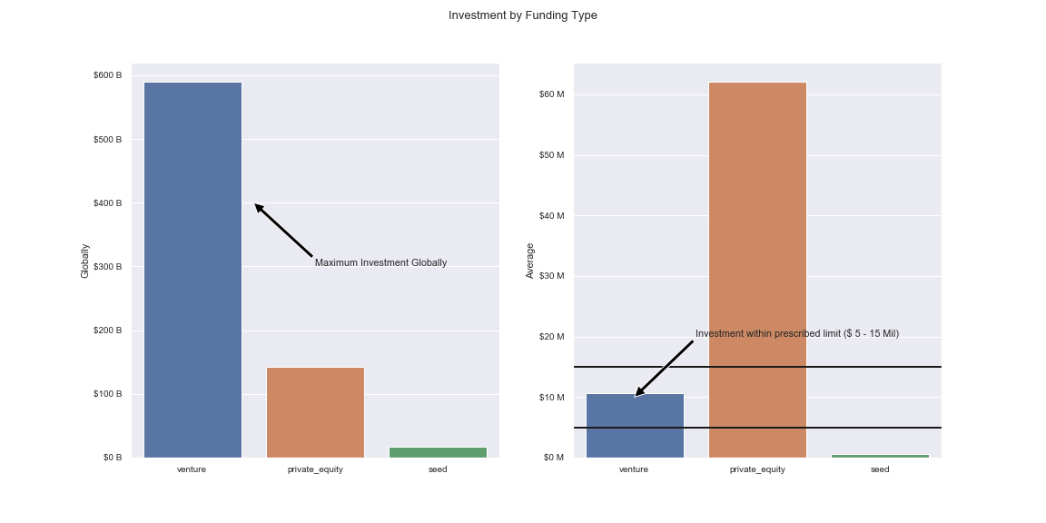
<Results – Investment by Funding Type>
Plot 1

Slide 8
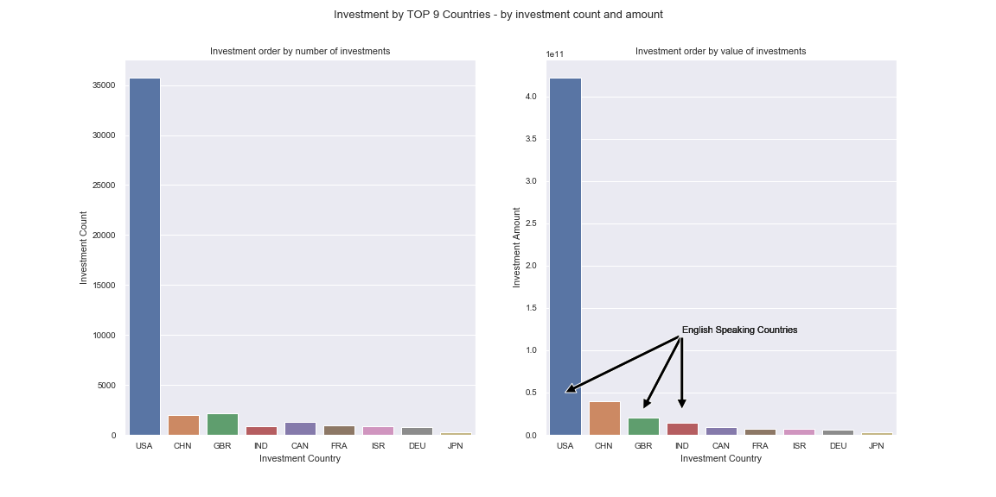
<Results – Investment by Top 9 Countries (by count and amount)>
Plot 2

Slide 9
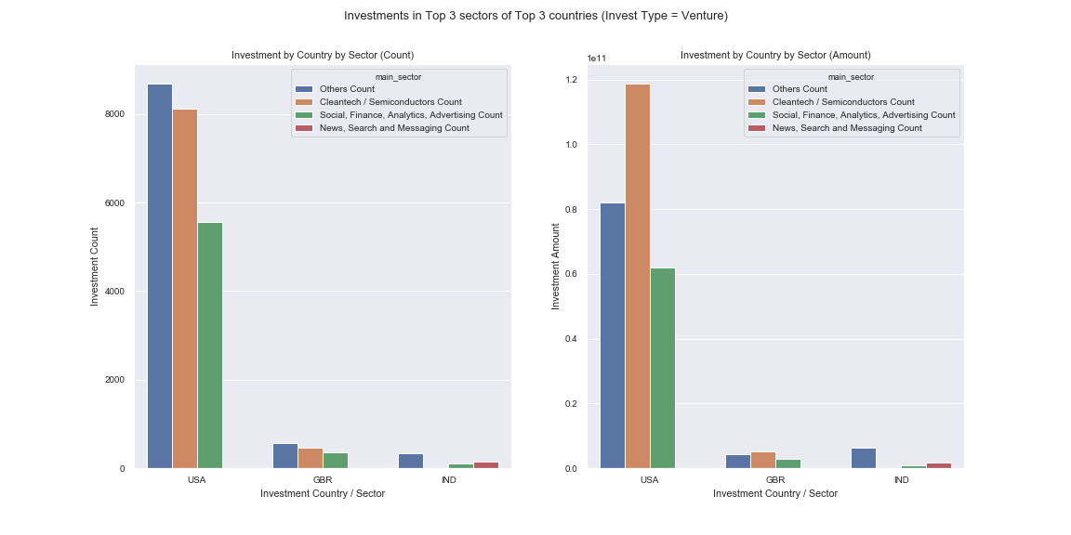
<Results>
Plot 3

Slide 10
<Conclusions>

